Slide 1


Basics Of Deep Learning

Slide 2
Basics Of Deep Learning

Slide 3

Basics Of Deep Learning
Deep learning is a subset of machine learning that uses multi-layered neural networks to analyze different factors with a structure that's similar to the human brain. It involves processing input data through layers to intelligently classify, recognize, and make predictions. The process entails forward progression through the network, starting from the input layer and moving towards the output layer.

Slide 4
Basics Of Deep Learning
Deep learning is a subset of machine learning that uses multi-layered neural networks to analyze different factors with a structure that's similar to the human brain. It involves processing input data through layers to intelligently classify, recognize, and make predictions. The process entails forward progression through the network, starting from the input layer and moving towards the output layer.

Slide 5
Perceptron
McCulloch-Pits Neuron
Developed in the 1940s, the McCulloch-Pitts neuron is a simplified model built from threshold logic, serving as the foundation for the modern-day perceptron.

Slide 6
Perceptron
Rosenblatt’s Perceptron Algorithm
McCulloch-Pits Neuron
Developed in the 1940s, the McCulloch-Pitts neuron is a simplified model built from threshold logic, serving as the foundation for the modern-day perceptron.
Rosenblatt's algorithm introduced the concept of a supervised learning rule for the perceptron model, enabling it to converge and learn from labeled training data.

Slide 7
Perceptron
Rosenblatt’s Perceptron Algorithm
Single Layer Perceptron
McCulloch-Pits Neuron
Developed in the 1940s, the McCulloch-Pitts neuron is a simplified model built from threshold logic, serving as the foundation for the modern-day perceptron.
Rosenblatt's algorithm introduced the concept of a supervised learning rule for the perceptron model, enabling it to converge and learn from labeled training data.
The single-layer perceptron is the simplest form, capable of linearly separating input data and categorizing it into binary classes using a linear decision boundary.

Slide 8
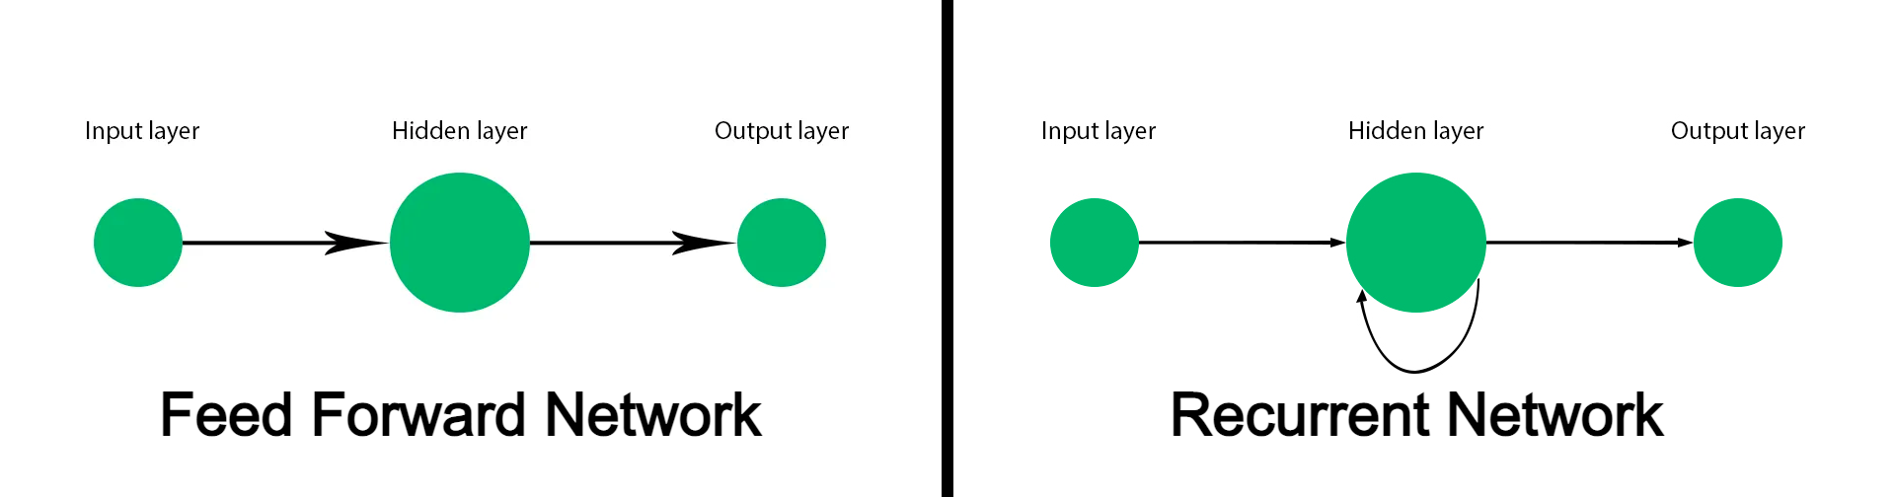
Forward Progression
Feedforward Network
The forward progression in deep learning involves the feedforward network, where the input data moves through the layers of the neural network in a unidirectional manner, without any feedback loops.

Slide 9
Forward Progression
Feedforward Network
The forward progression in deep learning involves the feedforward network, where the input data moves through the layers of the neural network in a unidirectional manner, without any feedback loops.

Slide 10
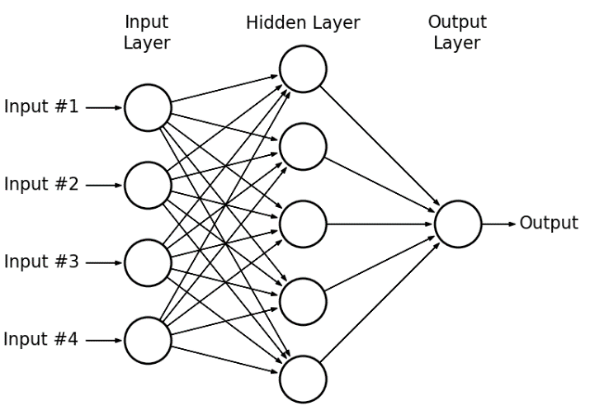
Layer-By-Layer Transformation
Each layer in the neural network transforms the input data, extracting relevant features and passing the processed information to the next layer for further analysis.

Slide 11
Layer-By-Layer Transformation
Each layer in the neural network transforms the input data, extracting relevant features and passing the processed information to the next layer for further analysis.

Slide 12
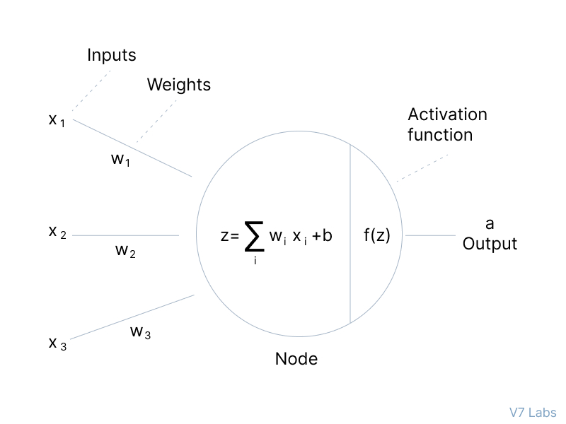
Activation Functions
During forward progression, activation functions like ReLU and Sigmoid are used to introduce non-linearity, enabling the network to learn complex patterns and relationships in the data.

Slide 13
Activation Functions
During forward progression, activation functions like ReLU and Sigmoid are used to introduce non-linearity, enabling the network to learn complex patterns and relationships in the data.

Slide 14
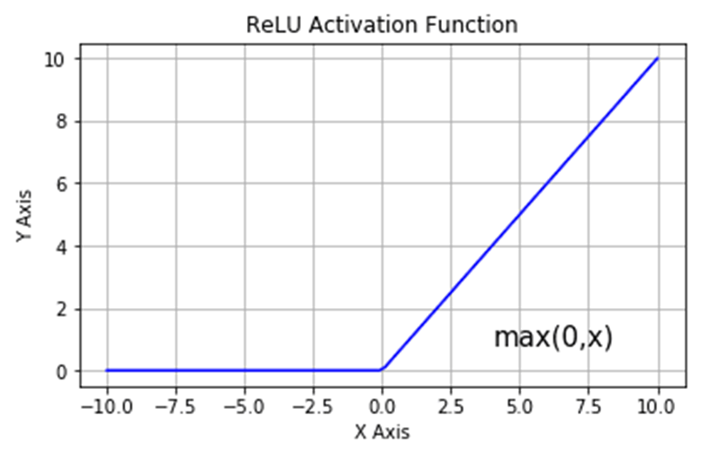
Activation Functions
ReLU (Rectified Linear Unit
ReLU is a simple yet effective activation function that overcomes the vanishing gradient problem and reduces the likelihood of the exploding gradient issue.

Slide 15
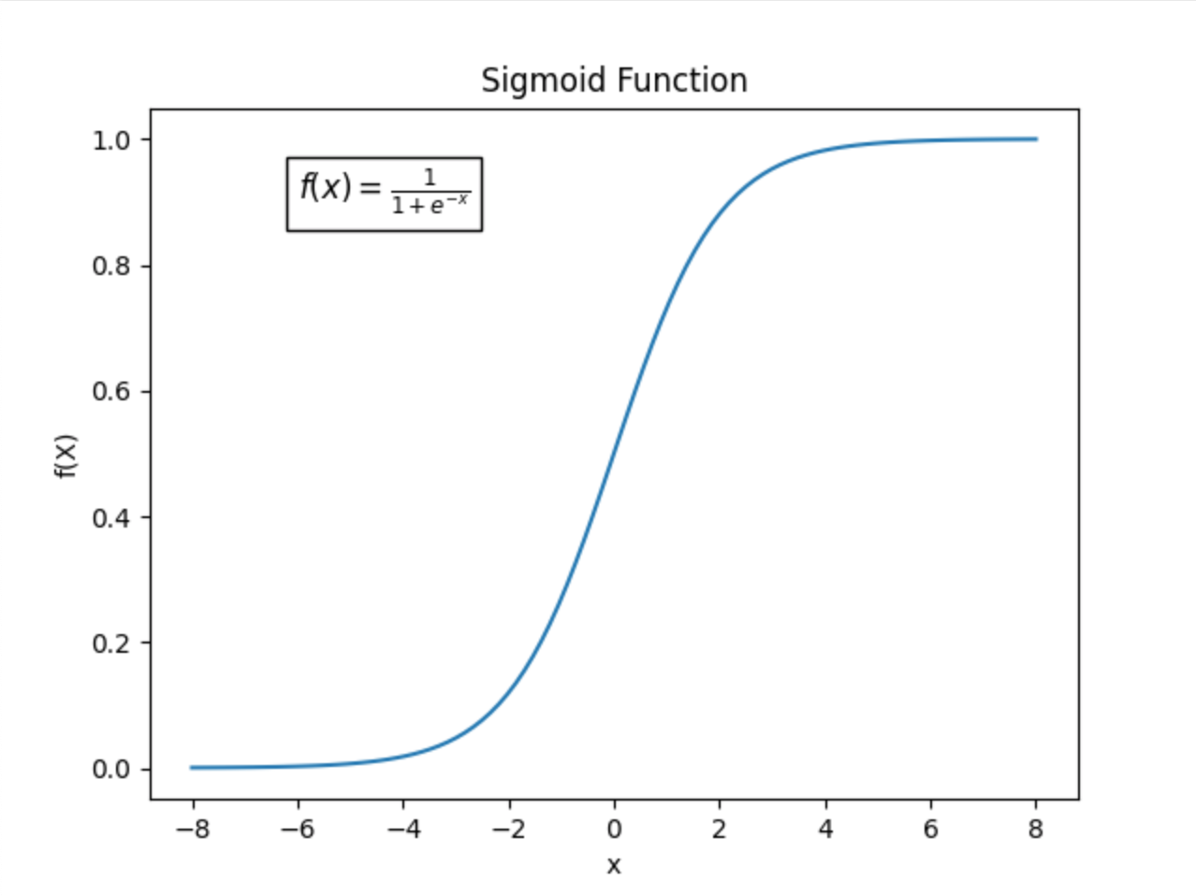
Sigmoid
Sigmoid function is widely used for binary classification tasks, transforming the output to a range between 0 and 1, indicating the probability of belonging to the positive class.

Slide 16
Sigmoid
Sigmoid function is widely used for binary classification tasks, transforming the output to a range between 0 and 1, indicating the probability of belonging to the positive class.

Slide 17
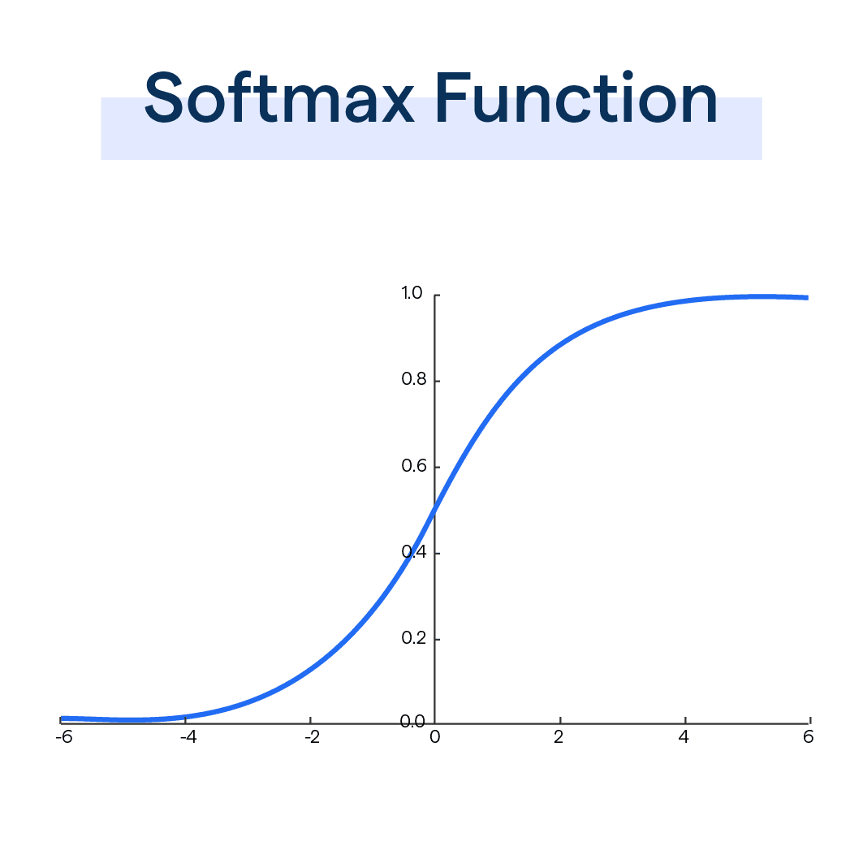
Softmax
Softmax serves as an activation function in the output layer of neural networks, transforming raw logits into probabilities for multi-class classification.

Slide 18
Softmax
Softmax serves as an activation function in the output layer of neural networks, transforming raw logits into probabilities for multi-class classification.

Slide 19
Backward Progression

Slide 20
Backward Progression
Error Calculation : Backward progression involves calculating the error or loss at the output layer, which measures the disparity between predicted and actual values in the training data.
Backpropagation : The error is then propagated backward through the network, layer by layer, to adjust the weights and biases and minimize the overall error through an optimization algorithm.
Gradient Descent : Various optimization algorithms, such as gradient descent and its variants like Adam and RMSprop, are used to update the network's parameters and minimize the loss function during backward progression.

Slide 21
Backward Progression
Error Calculation : Backward progression involves calculating the error or loss at the output layer, which measures the disparity between predicted and actual values in the training data.
Backpropagation : The error is then propagated backward through the network, layer by layer, to adjust the weights and biases and minimize the overall error through an optimization algorithm.
Gradient Descent : Various optimization algorithms, such as gradient descent and its variants like Adam and RMSprop, are used to update the network's parameters and minimize the loss function during backward progression.

Slide 22
Backward Progression
Error Calculation : Backward progression involves calculating the error or loss at the output layer, which measures the disparity between predicted and actual values in the training data.
Backpropagation : The error is then propagated backward through the network, layer by layer, to adjust the weights and biases and minimize the overall error through an optimization algorithm.
Gradient Descent : Various optimization algorithms, such as gradient descent and its variants like Adam and RMSprop, are used to update the network's parameters and minimize the loss function during backward progression.

Slide 23
Optimizers
Gradient descent is a fundamental optimization algorithm that adjusts the parameters of the neural network to minimize the loss by moving in the direction of the steepest descent.
Gradient Descent

Slide 24
Optimizers
Gradient descent is a fundamental optimization algorithm that adjusts the parameters of the neural network to minimize the loss by moving in the direction of the steepest descent.
Gradient Descent
Adam is an adaptive learning rate optimization algorithm that combines the advantages of AdaGrad and RMSprop, suitable for non-stationary objectives and noisy data.
Adam Optimizer

Slide 25
Loss Functions
MSE measures the average of the squares of the errors or differences between actual and predicted values, widely used for regression problems in deep learning.
Mean Squared Error (MSE)
Cross-entropy loss evaluates the performance of classification models by estimating the difference between the predicted and actual class distributions.
Cross Entropy Loss

Slide 26


Thank You !! Feel Free To Question
Slide Content Written by : Amaan and Arsh
Slide Design and Animations by : Vineet

